Slide 1
Welcome to MDS! Orientation 2024
August 28 and 29, 2024

Slide 2
Agenda today - Welcoming remarks and introductions - Stats and Orientations Overview - “Learning How to Learn” - Lunch - Meet your Faculty Section Chair - Program Outline/”The Growth Mindset” - Installation Helpdesk
Notes:
Milad

Slide 3
Land Acknowledgement
I would like to begin by acknowledging that the land on which we gather is the traditional, ancestral, and unceded territory of the xwməθkwəy̓əm (Musqueam) People.
Notes:
Kenna

Slide 4
Welcoming Remarks Dr. Giuseppe Carenini, Director MDS Programs Dr. Tiffany Timbers, Co-Director, MDS V Dr. Varada Kolhatkar, Co-Director, MDS V Dr. Garrett Nicolai, Director, MDS CL
Notes:
Matias

Slide 5
Welcoming Remarks Dr. Anne-Michelle Tessier, Assistant Head Linguistics Dr. Matias Salibian-Barrera, Acting Head Statistics Dr. Margo Selzer, Co-Head Computer Science
Notes:
AMT and Paul

Slide 6
Introductions MDS CL Team
Garrett Nicolai, Director and Assistant Professor of Teaching
Kenna McEwan, Program Manager
Adrianne Chang, Graduate Program Assistant
Sonya Thomlinson, Career Advisor
Jungyeul Park, Lecturer
Jian Zhu, Assistant Professor of Research
Scott Mackie, Assistant Professor of Research
Muhammad Abdul-Mageed (on Leave), Assistant Professor of Research
Notes:
Kenna

Slide 7
Introductions MDS V Team
Prajeet Bajpai, Post Doctoral Research and Teaching Fellow
Katie Burak, Assistant Professor of Teaching
Giuseppe Carenini, Director, MDS Programs
Ben Chen, Course Coordinator
Daniel Chen, Lecturer
Jean Caballero, Program Manager
Gittu George, Lecturer
Vanessa Ho, Marketing and Communications Coordinator
Vincent Liu, Post Doctoral Research and Teaching Fellow
Varada Kolhatkar, Co-Director and Assistant Professor of Teaching
Notes:
Milad

Slide 8
Introductions MDS V Team
Milad Maymay, Director of Program Operations and Student Management
Joel Ostblom, Assistant Professor of Teaching
Angela Pau, Career Advisor
Hema Ratnasami, Senior Graduate Program Assistant
Alexi Rodriguez-Arelis, Assistant Professor of Teaching
Andy Tai, Post Doctoral Research and Teaching Fellow
Tiffany Timbers Co-Director and Assistant Professor of Teaching
Heddy Zarkoob, Post Doctoral Research and Teaching Fellow
Betty Zhao, Course Coordinator
Zac Warham, Course Coordinator (starting in September)
Ilya (starting in January)
Notes:
Milad

Slide 9
MDS History and Statistics

Slide 10
MDS History
MDS Vancouver Launched in 2016
Industry consultation
Unique partnership between CS, Stats and Ling
One of the 1st Masters level Data Science programs
Curriculum designed from scratch
UBC Okanagan campus MDS program in 2018
Specialization in Computational Linguistics in 2019
2 MDS V sections 2024
Notes:
Milad

Slide 11
MDS Diversity
MDS V (Cohort 9)
135+ students
30 different nationalities
MDS CL (Cohort 6)
35+ students
13 different nationalities
Notes:
Kenna

Slide 12
MDS Diversity (MDS V + MDS CL)
Arts: 21
Finance, Business, Management, Economics: 37
Engineering: 29
Health/Life Sciences (Biochemistry, Biology, Physics, Chemistry, etc.): 22
Computer Science/Computer Engineering: 42
Stats and Math: 27
Data Science: 8
Other (Education, Forestry, etc.): 6
Notes:
Milad

Slide 13
MDS Diversity (MDS V + MDS CL)
PhD, Master’s and Bachelor’s
From more than 80 different institutions around the world
Years since last degree:
6 or more years: 43
3-5 years: 54
1-2 years: 47
0-1 years: 46
Notes:
Kenna

Slide 14
MDS Alumni
More than 900 alumni, most working in Greater Vancouver, Toronto, Calgary, Seattle, Silicon Valley
Close knit Community – MDS Alumni Slack, Alumni Events, Reunions, Mentoring, etc.
Notes:
Milad

Slide 15
Orientation Overview

Slide 16
MDS V and MDS CL
Rest of Today
11:15-12: “Learning How to Learn”
12-1:15: Lunch
- Boxed lunch; Eat outside because this room will be divided into 2
- After lunch you will be divided into your sections (see your nametag)
- Section 1 will be on the ”left” side; Section 2 in the “right” side.
SECTION 1 |  |  |  | SECTION 2
Time | Event | Facilitator |  | Event | Facilitator
1:15-1:25 | Meet the Faculty Section Chair | Katie |  | Meet the Faculty Section Chair | Alexi
1:25-2:10 | Program Outline (MDS Philosophy, How to succeed, Capstone expectations, etc.) | Tiffany/Garrett |  | The Growth Mindset | Varada
2:15-3 | The Growth Mindset | Tiffany |  | Program Outline (MDS Philosophy, How to succeed, Capstone expectations, etc.) | Varada/Garrett
Notes:
Milad

Slide 17

MDS V and MDS CL
Rest of Today
3:15-5 | Installation Help Desk (Sign Up on Qualtrics) | Academic Team
Arrive at your timeslot. Faculty will be outside the room to help.
Notes:
Milad- CL students D1, V D1/D2

Slide 18
MDS V ONLY
Tomorrow, Thursday, August 29
The Great Hall, The Student NEST
Day 2: Thursday Aug 29; MDS V Students only Location: The Great Hall, The Student NEST, 6133 University Boulevard.
SECTION 1 |  | SECTION 2
Time | Event | Event
9:15 | Breakfast | Breakfast
9:30-10 | Policies and Procedures | Policies and Procedures
10-10:30 | Career Orientation | Career Orientation
10:30-10:45 | Break | Break
10:45-11:45 | Alumni Talk: Tips on How Survive and Strive in MDS | Alumni Talk: Tips on How Survive and Strive in MDS
11:45-12:30 | Lunch | Lunch
12:30-3:20 | Team Building: Campus Goose Chase | Team Building: Campus Goose Chase
3:30-5 | Installation Help Desk (Sign Up on Qualtrics)
Notes:
Milad

Slide 19
MDS V ONLY
Friday Aug 30: First Day of Classes and Labs
Friday Sep 13, 1:30-3:30pm: Equity, Diversity and Inclusion Workshop Location (various rooms, Henry Angus Building)
Thursday Sep 5, 5-9pm: Cohort Dinner Social with Alumni Talk, Riya Eliza Shaju (Class of 2024) Location: Jack Poole Hall, 2nd Floor, Robert H. Lee Alumni Centre, 6163 University Blvd.
Notes:
Milad

Slide 20
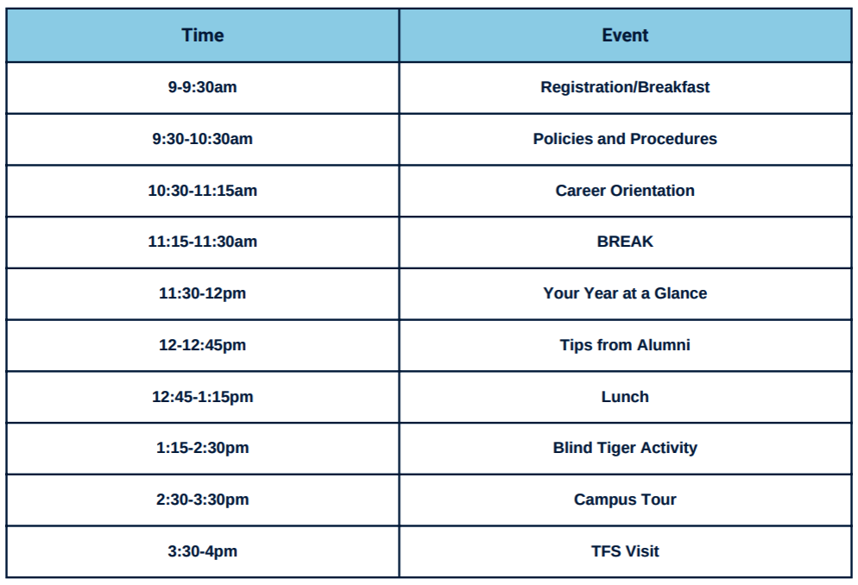
MDS CL ONLY
Tomorrow, Thursday, August 29th
The GSS Loft, The Student NEST
Notes:
Kenna

Slide 21
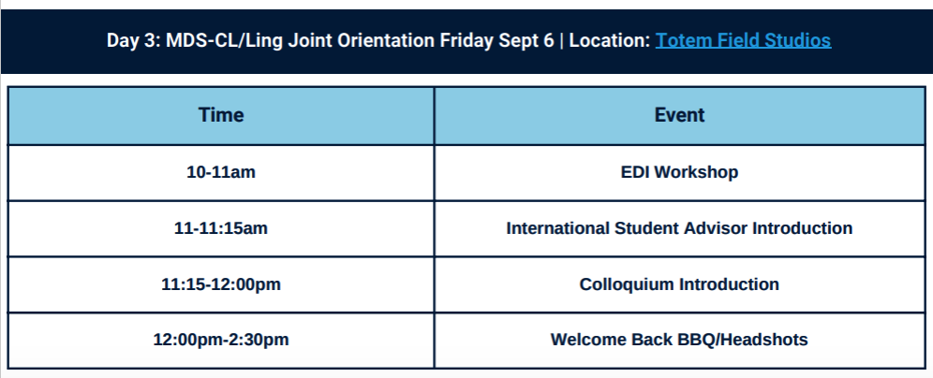
MDS CL ONLY
Friday Aug 30: First Day of Classes and Labs
Friday, September 6th
Totem Field Studios
Notes:
Kenna- reminder that lunch will be served on the 6th and you need to book your headshot slot by the end of the day today (link will be put in the CL slack channel during lunch)

Slide 22
BREAK

